Slide 1
Finger Vein Recognition
By:
Minakshy Ramachandran-A20396350
Puneet Paul SINGH-a20404848
Samruddhi NAIK-A20381084

Slide 2
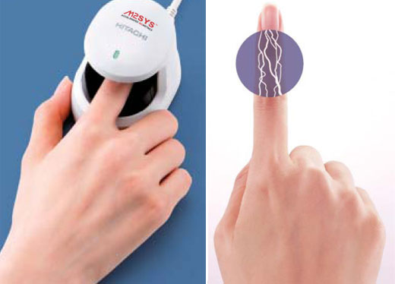
Introduction
Finger vein recognition is a method of biometric authentication that uses pattern-recognition techniques based on images of human finger vein patterns beneath the skin's surface.
Current applications of finger vein recognition includes credit card authentication, automobile security, employee time and attendance tracking, automated teller machines etc.

Slide 3
Abstract
In recent years, finger vein recognition has become an important sub-field in biometrics and been applied to real-world applications.
In 2017, International Competition on Finger Vein Recognition, the winner dramatically improved the EER from 2.64% to 0.83% only.
Through this paper we will give insights on development of finger vein recognition algorithms.

Slide 4
PROS & CONS
PROS:
Non-contact
Live Sampling
High Accuracy
Fast Authentication
CONS:
Lack of data sets
Public data sets have small number of images
No professional online platform for researchers to evaluate their algorithm.

Slide 5
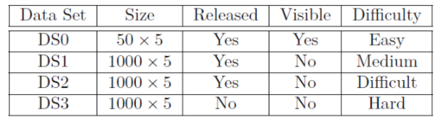
ICFVR 2017 (International Competition on Finger Vein Recognition 2017)
Recognition Algorithm Test Engine (RATE) is used as an evaluation platform for the Finger Vein Recognition.
4 datasets are used i.e. DS0, DS1, DS2 & DS3.

Slide 6
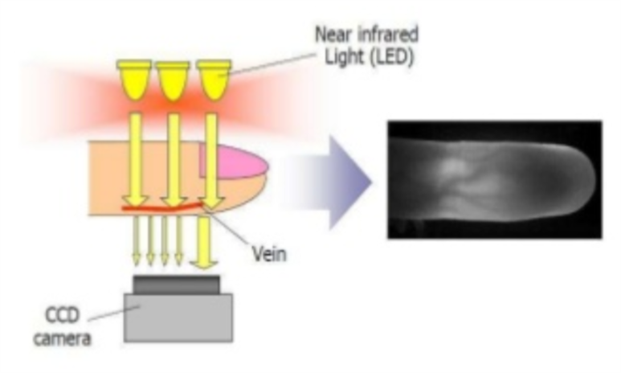
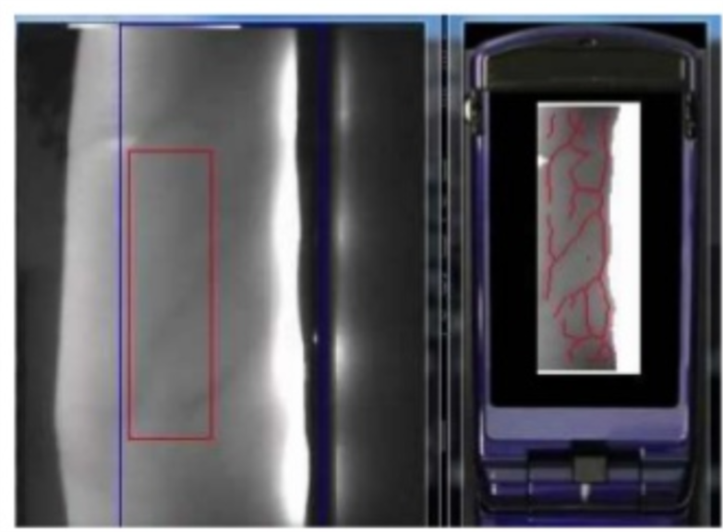
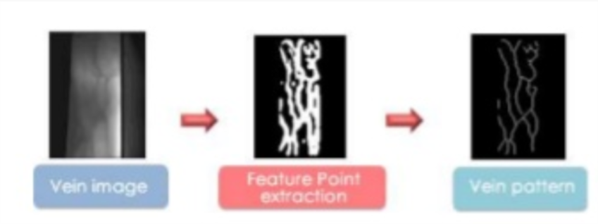
Algorithms Used
All the teams, who participated in competition, used different kinds of approach such as:
Edge Detection, Image Pre-Processing, Feature Extraction & comparison.(T5)

Slide 7
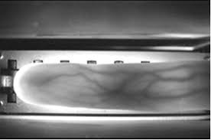
Contd…
Wide line detector algorithm on the basis of on the basis of isotropic non linear filtering. (T7)
Intercept an ROI area of the input and save the grey scale information as template and for matching, compare the grey scale information of two templates. (T9)

Slide 8
Results
RATE automatically generates the following characteristics for each system of the finger vein recognition:
FMR & FNMR
EER
Zero FNMR and Zero FMR
Fail to Enroll & Fail to Match
Average enroll and match time
Detection error Trade-off curves
Genuine & Impostor Score distribution histograms

Slide 9
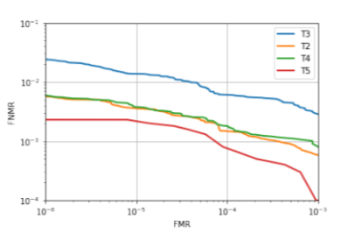
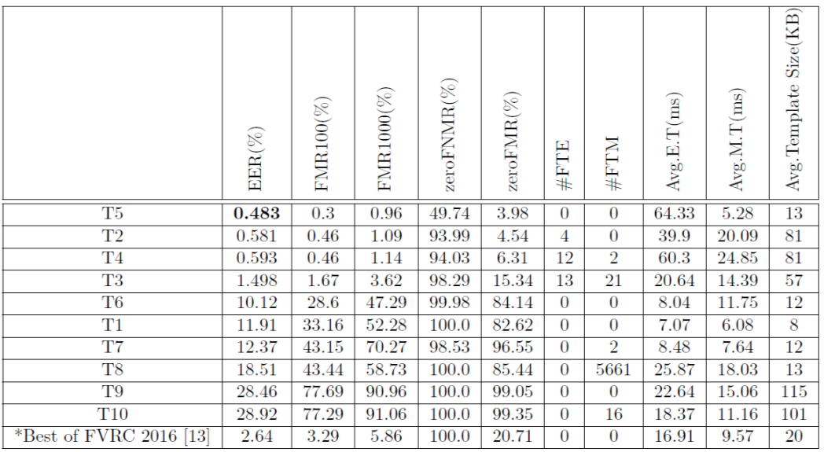
Competition Results
Team 5 was declared as the winner based on the following observations:

Slide 10
Analysis
An intricate environment increases the recognition difficulty.
Images acquired outdoors are prone to light overexposure, light leak and light underexposure, which increases the difficulty of extracting features of veins.
The range of time taken to capture the dataset is an influential factor.
Algorithm which reduces or removes the impact of lighting, and rectifies the position and angle of the fingers is considered the best.

Slide 11
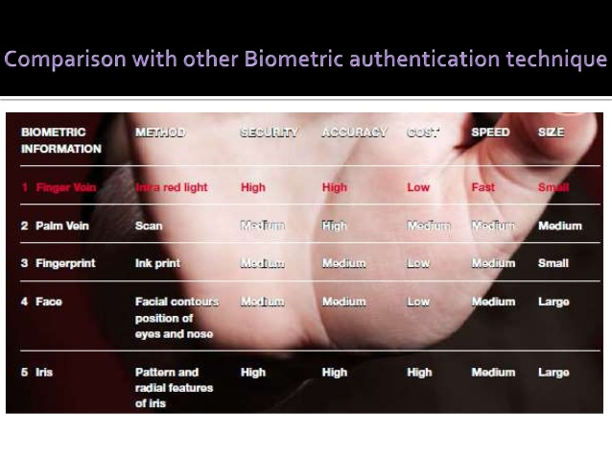
Conclusion

Slide 12
Contd…
With the final results of ICVFR 2017, the algorithms available for finger vein recognition are much more accurate and secure now.
Finger Vein Recognition can be a thing in future due to less cost involved as compared to other Biometric techniques.
https://www.youtube.com/watch?v=g7M9hCYlLXg

Slide 13
References
ICFVR 2017: 3rd International Competition on Finger Vein Recognition
www.bayometric.com
www.youtube.com

